Slide 1

Welcome
Agile Testing
Notes:
Mandatory
ACTION: Adjust title to fit your course.

Slide 2
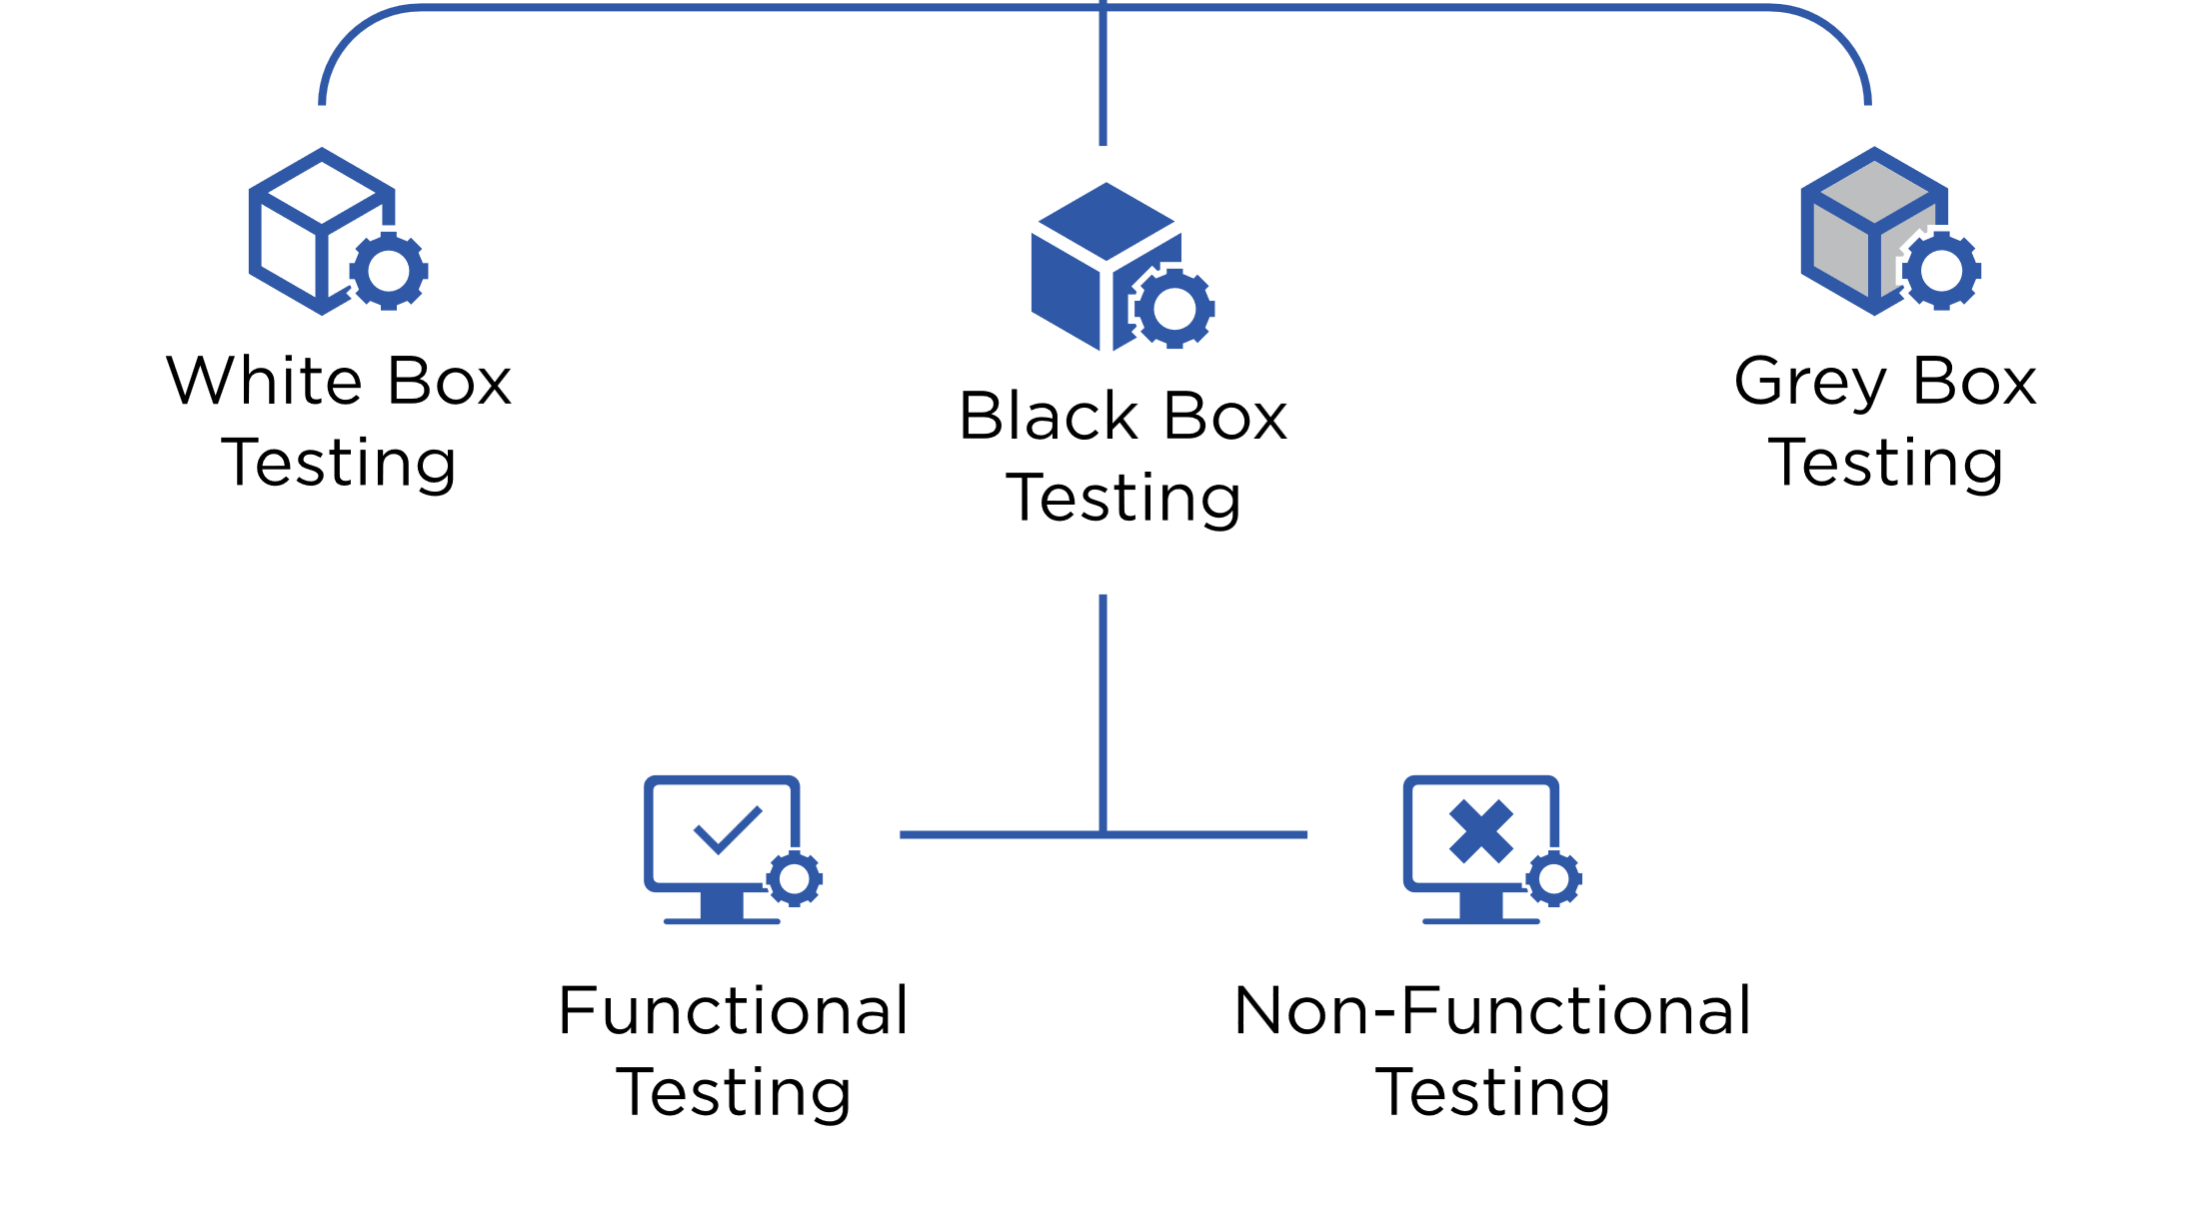
What is software testing?
Software testing is the act of:
Examining the artifacts and the behavior of the software under test by validation and verification.
Software testing can also provide an objective, independent view of the software to allow the business to appreciate and understand the risks of software implementation.
- Wikipedia
Notes:
Testing in an Agile environment is an integral part of the software development process. Agile methodologies, such as Scrum, Kanban, and Extreme Programming (XP), emphasize delivering high-quality software through iterative and incremental development. Testing in an Agile environment follows certain principles and practices that promote early testing, continuous feedback, and collaboration between developers and testers

Slide 3
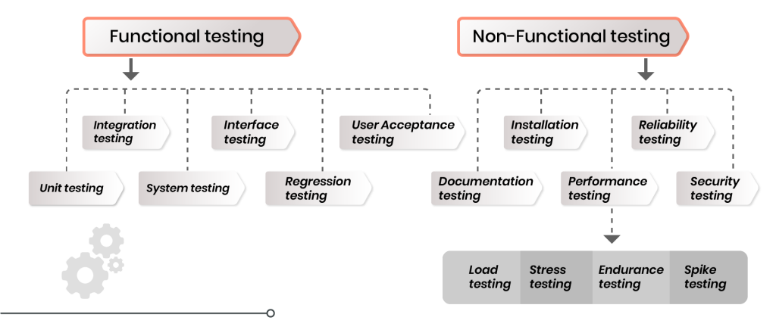
Types of software testing
Notes:
There are various types of software testing that address different aspects of a software application's quality, functionality, and performance. These testing types are designed to uncover defects, verify functionality, and ensure that the software meets the specified requirements. Here are some common types of software testing:
Unit Testing: This involves testing individual components or modules of the software in isolation. Unit tests verify that each unit of code works as intended and meets its design specifications.
Integration Testing: Integration tests focus on interactions between different components or modules of the software. The goal is to identify any issues that arise when these components are integrated.
Functional Testing: Functional testing verifies that the software's features and functions work as expected, based on the defined requirements. It involves testing various scenarios and inputs to ensure correct behavior.
Regression Testing: Regression testing ensures that recent code changes or updates do not negatively impact existing functionalities. It involves retesting previously tested areas to catch regressions or unintended consequences.
User Acceptance Testing (UAT): UAT is conducted by end-users to validate whether the software meets their requirements and expectations. It helps ensure that the software is ready for release to users.
Performance Testing: Performance testing assesses how well the software performs under various conditions, such as load, stress, and scalability. It aims to identify bottlenecks, performance issues, and resource limitations.
Security Testing: Security testing examines the software's vulnerabilities and weaknesses to ensure that it is resistant to unauthorized access, attacks, and data breaches.
Usability Testing: Usability testing evaluates the software's user-friendliness and ease of use. It focuses on aspects such as user interface design, navigation, and user interactions.
Compatibility Testing: Compatibility testing checks how well the software performs across different devices, browsers, operating systems, and network environments.
Smoke Testing: Also known as build verification testing, smoke testing is a quick preliminary test to ensure that the software's critical functionalities are working after a new build or release.

Slide 4

Types of Tests

Slide 5
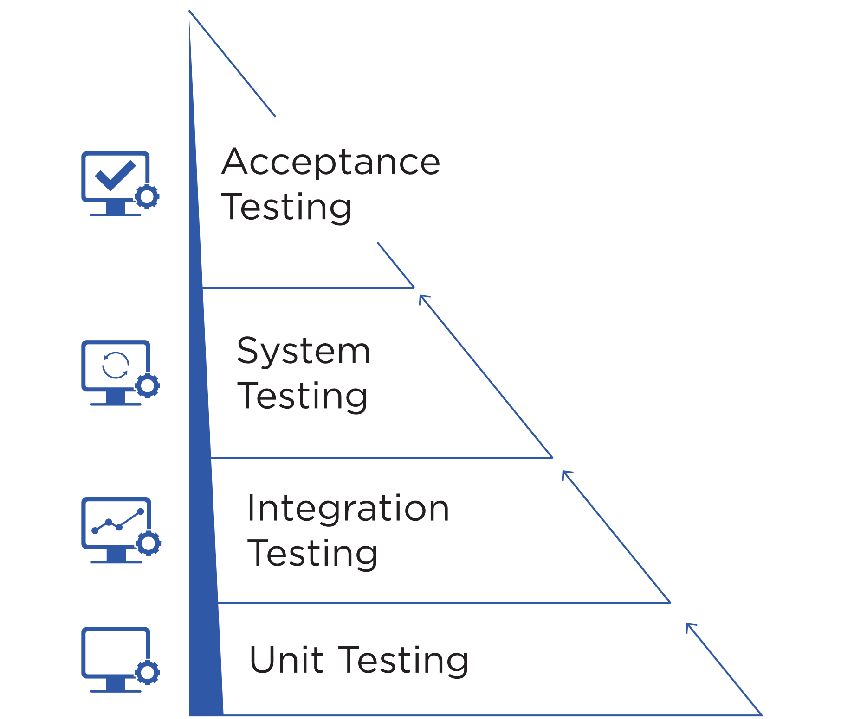
Unit Testing
Manual Tests
Usually written by developers
Uses Assertions
Testing smallest part of the system in isolation
Best Performance – execute early, often and within few seconds
Smallest scope - easier to locate and understand errors
Frequency – Every code check-in or pull request
Use of test doubles to replace dependencies – dummies, stubs, spikes, mocks
Increases confidence in changing/maintaining code
Notes:
Unit testing is a software testing practice in which individual components or units of code are tested in isolation to ensure that they function correctly. A unit refers to the smallest testable part of a software application, often a single function, method, or procedure. The primary goal of unit testing is to verify that each unit of code works as intended and meets its design specifications.
Unit testing significantly contributes to software quality by catching defects early in the development process. It helps ensure that individual units of code are reliable, functional, and meet the intended behavior. While unit testing focuses on the smallest code components, it plays a crucial role in building a solid foundation for the overall software application.

Slide 6
Middle Layer Testing
Manual Tests
Together called as service/API layer tests, also termed as “middleware layer”.
Component Tests: Look at individual components. Validates the functionality is working as expected with other components.
Integration Tests: Targets modules/features that integrate directly with other dependencies outside the application. Can be used as gating/staging from preprod to prod etc.
System Integration Tests: Large scale integration suite testing end-to-end workflows. Often coordinated across teams and unique to your application or system.
Notes:
Middle layer testing, also known as integration testing or component testing, is a type of software testing that focuses on verifying the interactions and interfaces between various modules, components, or services within a software application. The goal of middle layer testing is to ensure that different parts of the application work together seamlessly and produce the expected outcomes when integrated.
Middle layer testing is especially important in complex software applications where different components interact to provide specific features and functionality. By validating the integration points and interactions, middle layer testing helps prevent defects from propagating to higher-level testing stages and ensures the overall reliability of the software application.

Slide 7
Acceptance Testing
Manual Tests
Similar to integration tests in the sense that they test different parts of the application
End-to-end testing
Ensure high-level functionality works as expected or described and delivers business value
Maximum scope such as - logics, UI workflows, navigation, transitions, calculations, buttons, layouts etc.
Can be brittle or flaky and a lot of work to maintain
Test critical workflows
Notes:
Acceptance testing is a software testing phase that assesses whether a software application meets the specified requirements and is ready to be accepted by stakeholders, users, or customers. The primary objective of acceptance testing is to validate that the software satisfies user needs, works as intended, and aligns with the business goals.
Acceptance testing provides a final validation of the software's readiness for deployment. It helps ensure that the software meets user needs, is aligned with business objectives, and is free from critical defects. This phase bridges the gap between development and deployment, offering stakeholders confidence in the software's quality before it is launched to a wider audience.

Slide 8
Manual Testing
Manual Tests
Not regression testing
Experience + creativity
Learn about the system, discover defects & improve automated testing
Can be based on missions/test charter/persona
Covers scenarios which can’t be automated or are too complex to automate
Edge Scenarios for mission critical applications to prevent failure
Notes:
Manual testing is a software testing technique in which test cases are executed by human testers without the use of automated testing tools or scripts. It involves systematically going through the software application, interacting with its various features, and comparing the actual results with expected outcomes to identify defects and ensure its quality.
Despite its advantages, manual testing has limitations, such as being time-consuming for repetitive tests, less suitable for large-scale applications, and more prone to human errors. Automated testing is often preferred for long-term regression testing and executing repetitive tasks. However, manual testing remains valuable for exploratory, ad-hoc, usability, and initial testing, as well as for scenarios where human judgment and creativity are required.

Slide 9
Performance, Security, Scalability
Manual Tests
Performance Testing - Generating data or metrics on the performance of your application. E.g. – A tipping point where your application can’t take any more requests.
Security Testing - To check for vulnerability and security loopholes resulting in loss or unauthorized access of data. E.g.- PID (Personal Identification Information) of application users.
Scalability Testing - Testing of a software application to measure its capability to scale up or scale out in terms of any of its non-functional capability.
Performance
Security
Scalability
Notes:
Performance testing is a type of software testing that evaluates how well a software application performs under various conditions, such as different levels of user load, response times, and stress. The goal of performance testing is to ensure that the software meets specified performance criteria, remains stable, and performs adequately even when subjected to demanding scenarios.
Security testing is a type of software testing that assesses the security features and vulnerabilities of a software application to identify potential security risks and weaknesses. The goal of security testing is to ensure that the application is protected against unauthorized access, data breaches, and other security threats.
Scalability testing is a type of performance testing that evaluates how well a software application can handle increased workloads, user traffic, and data volume while maintaining its performance, responsiveness, and stability. The goal of scalability testing is to determine the application's ability to scale up or down based on changing demands without degrading its performance or causing failures.

Slide 10
Unit Testing

Slide 11
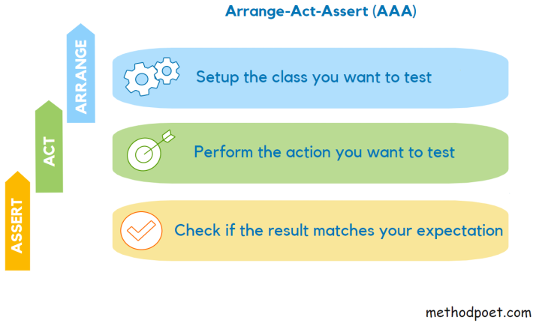
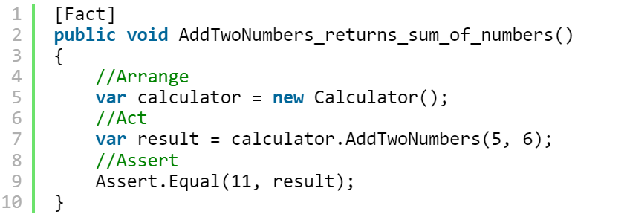
Unit test structure - AAA

Slide 12


Demo – Our first unit test
10 minutes
Instructions:
Check if the title of book is – “All the Light We Cannot See”
Steps:
- “Arrange“ an object of class “Book”
- “Act” by calling getTitle() method
- “Assert” the returned result
Notes:
Demo a JUnit test. If IDE not available, use notepad to demonstrate. Explain the test constructs
Example of a failing test
import org.junit.Test;
import static org.junit.Assert.*;
public class BookTest {
@Test
public void should_test_title_of_book() {
Book book = new Book("All the Light We Cannot See");
assertEquals("All the Light We Cannot See", book.getTitle());
}
private class Book {
public Book(String s) {
}
public String getTitle() {
return null;
}
}
}

Slide 13
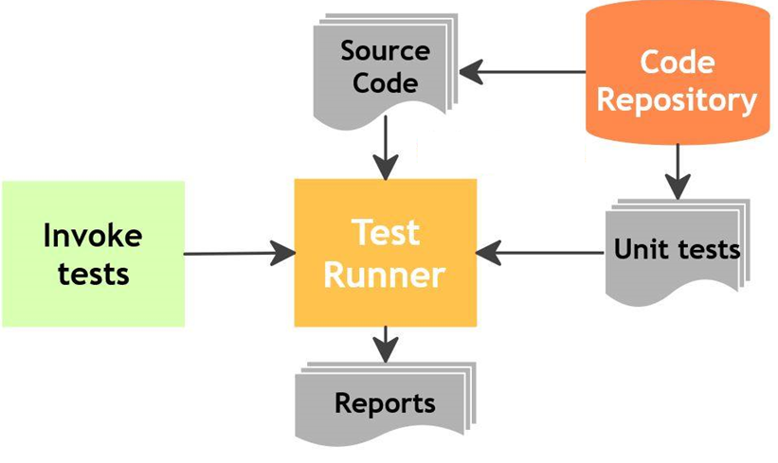
How was the first-code?
What did we just do?
What did you observe?
Did you understand the code?
What was new for you?
Notes:
Mandatory
ACTION: Adjust bullets as per your course.
In this section, discuss the structure of the course—exercises, labs, etc.
Also, discuss any resources students will be using.

Slide 14
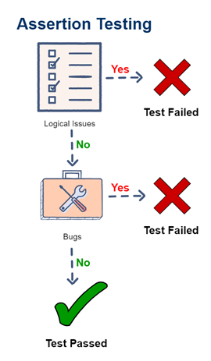
Assertion
Used to test a logical expression
At a binary level, assertion is just a Boolean expression – containing a true or false
Assertions are used to declare the expected behavior or outcome of a test
An assertion is true if the logical expression that is being tested is true and there are no bugs in the program.
Notes:
Mandatory
ACTION: Adjust bullets as per your course.
In this section, discuss the structure of the course—exercises, labs, etc.
Also, discuss any resources students will be using.

Slide 15
Why unit test?
Faster Debugging
Faster Development
Better Design
Excellent Regression Tool
Reduce future costs such as – bug fixes, maintenance, new additions etc.
Integration testing become much easier
Provides a living document of the system

Slide 16
Guidelines/Good Practices
Keep them small and fast (able to execute within seconds)
Should be fully automated
Simple to run
Measure the tests – code coverage
Fix failing tests immediately
Keep testing at unit level
Keep tests independent
Test the trivial cases too

Slide 17
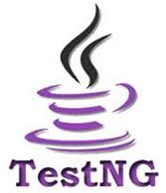

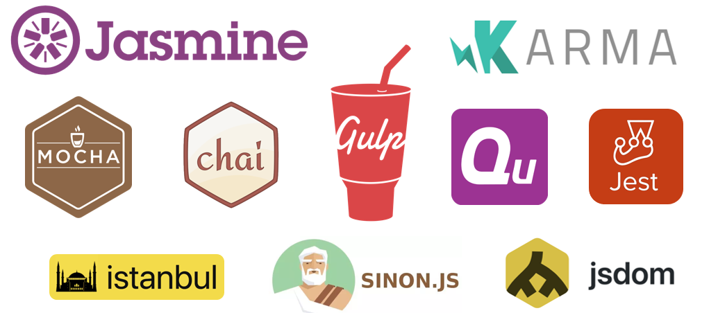

Unit test tools
And many more…

Slide 18
Activity – Write & execute few more unit tests
15-20 minutes
Instructions:
- Check ISBN of the book is – 1501173219
- Check publisher name is - Celadon Books
- Check the cost is $23.00

Slide 19
Testing in Agile – An Introduction

Slide 20
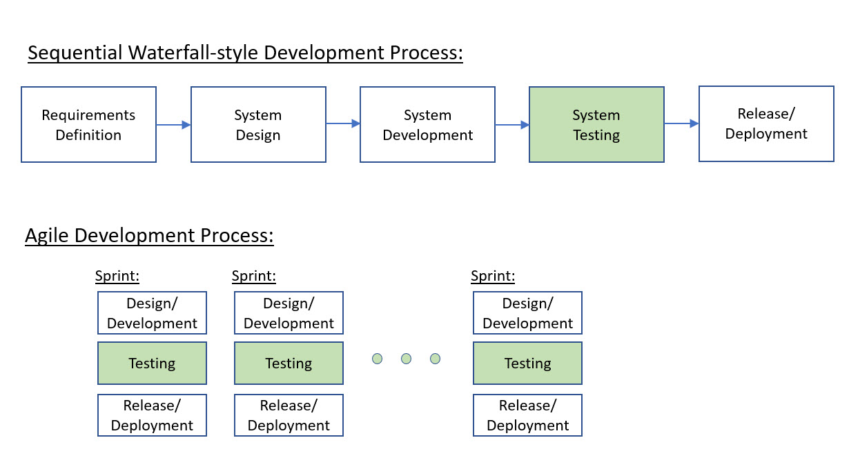
Agile Testing vs Traditional Testing

Slide 21
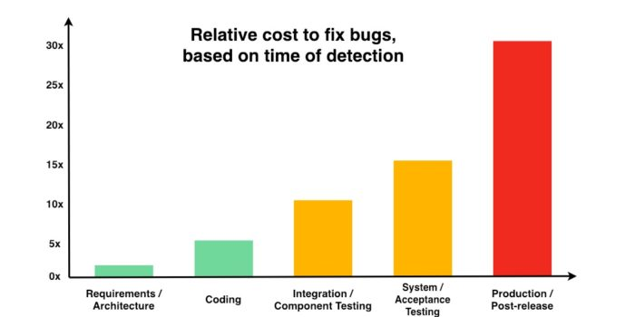
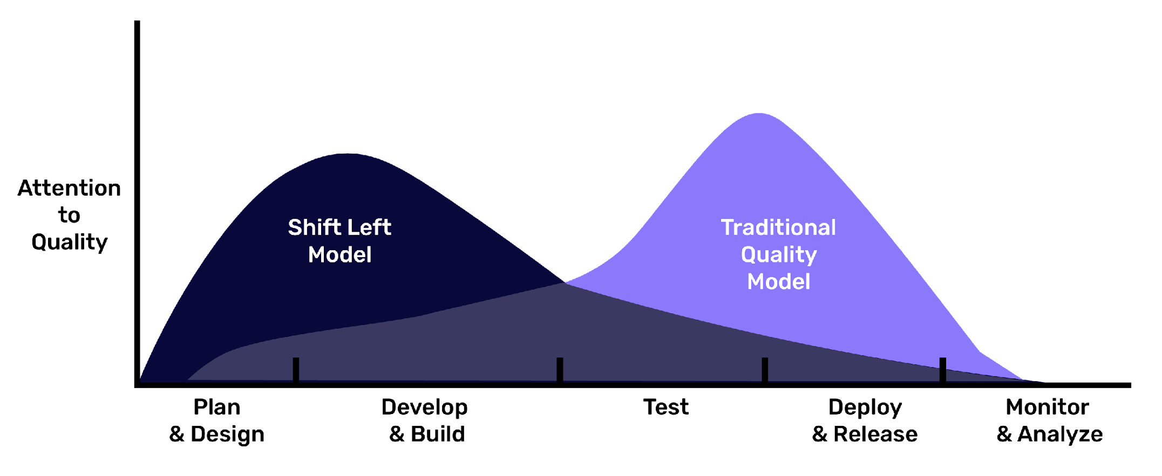
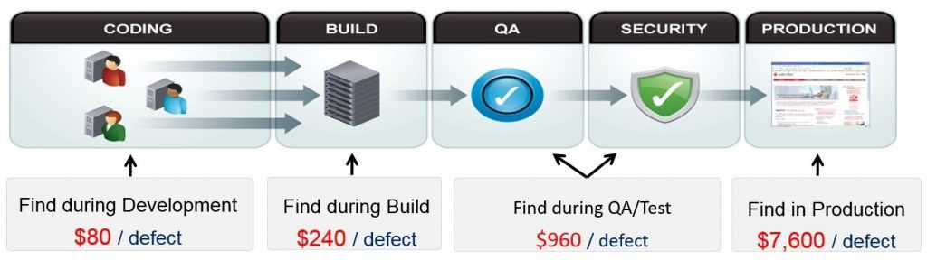
Shift left – why?
A research by Ponemon Institute, in 2017

Slide 22
Software Testing Tools and Techniques

Slide 23
Manual Testing
In manual testing , testers manually execute test cases without using any automation tools.
It requires a tester to play the role of an end user.
Any new application must be manually tested before its testing can be automated.
Manual testing requires more effort, but is necessary to check automation feasibility.
Manual testing does not require knowledge of any testing tool.
One key software testing principle is 100% Automation is not possible making manual testing imperative and important.

Slide 24
Why Automated Testing?
Challenging to test multilingual sites/interfaces manually.
Does not require human intervention.
Increases speed of test execution.
Increase test coverage exponentially.
Manual testing can become boring for testers and hence is error prone.

Slide 25
Automation Testing vs. Manual Testing
Automation Testing | Manual Testing
Perform same operation each time | Test execution is not accurate all the time, hence not reliable
Useful to execute a set of test cases frequently | Useful when the test case only needs to run once or twice
Fewer testers required to run test cases | Large number of testers required
Platform independent | Platform dependent
Testers can fetch complicated information from code | Does not involve any programming task to fetch hidden information
Faster | Slower
Not helpful in testing UI | Helpful in testing UI
High cost | Less than automation

Slide 26
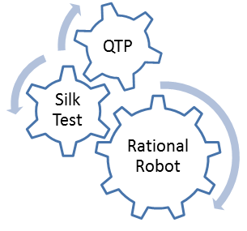
Automation tools
Some of the most popular test tools

Slide 27
Benefits of Automated Testing
Reliable: Tests perform precisely the same operations each time they are run, thereby eliminating human error.
Repeatable: You can test how the software reacts under repeated execution of the same operations.
Programmable: You can program sophisticated tests that bring out hidden information from the application.
Comprehensive: You can build a suite of tests that covers every feature in your application.
Reusable: You can reuse tests on different versions of an application, even if the user interface changes.
Fast: Automated tools run tests significantly faster than human users - approx. 70% faster than manual testing!
Better Quality Software: Because you can run more tests in less time with fewer resources
Cost Reduction: As the number of resources for regression test are reduced.

Slide 28
Automated test tool features
Essential
Highly Desirable
Nice to Have

Slide 29
Static Test Tools
Static analysis tools are generally used by developers as part of the development and component testing process.
They can help developers to understand the structure of the code.
They can also be used to enforce coding standards.
These tools do not involve actual input and output.
Static analysis tools are an extension of compiler technology.

Slide 30




Thank you!
Notes:
Mandatory -- Need bookend -- first and last thing they should see is DevelopIntelligence
ACTION: Use this for the final slide of your class materials.

